Slide 1
Project Proposal
Metric converter
Group: Nathan Collins, Pau Ferrer, Nolan Falk

Slide 2
Metric converter
Simple Metric converter GitHub
Has three current features:
Converts Fahrenheit to Celsius
Converts inches to centimeters
Converts miles to kilometers

Slide 3
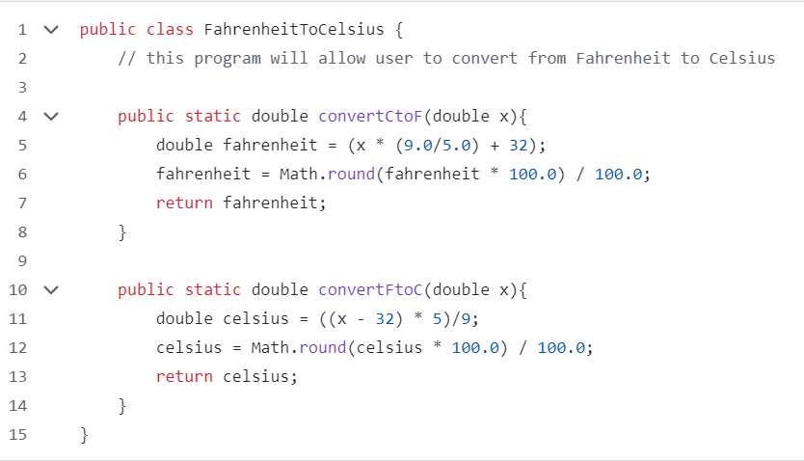

Slide 4
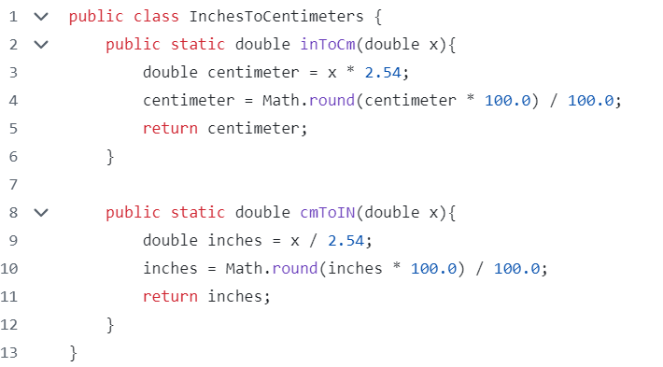

Slide 5
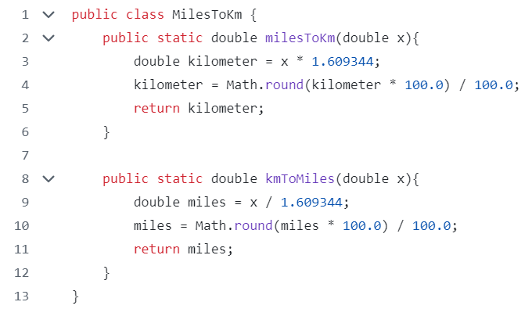

Slide 6
Project plans
Add these current features to one abstract Converter class
1
Implement logic to execute correct conversions
2
Implement more conversion features
3

Slide 7
Methods
The Converter class will have a convert method that takes 3 arguments and returns the conversion
Argument 1: value to convert
Argument 2: unit of the value
Argument 3: unit to convert to

Slide 8
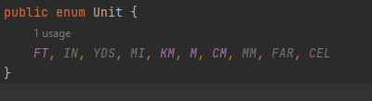



Slide 9
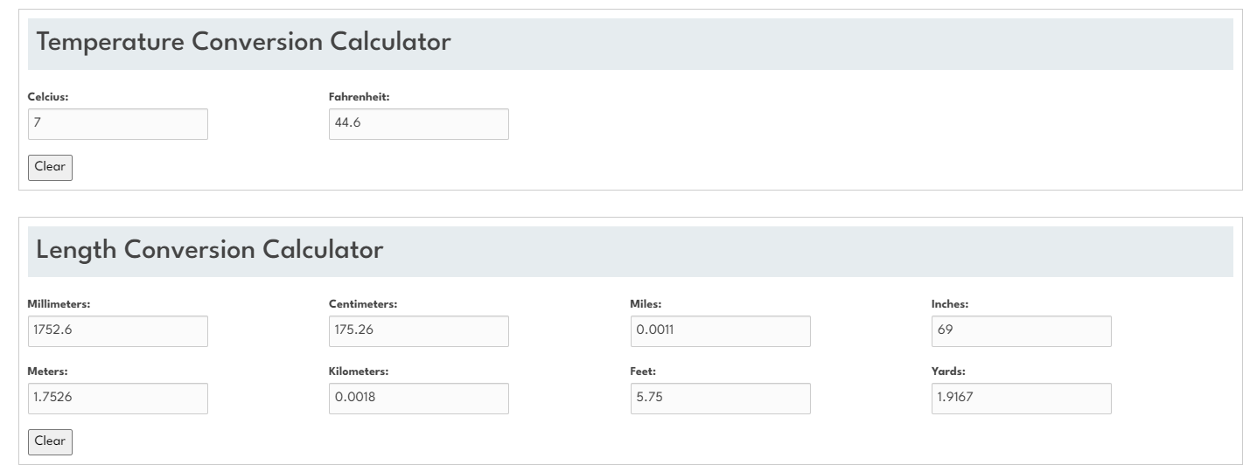

Slide 10
New Features
One convert method, uses logic to perform correct conversion
Add logic to check for incompatible conversion
Add new conversions, for weight
Add new conversions, for volume
Add new conversions, for time
Add additional units for length

Slide 11
Types of testing we will use
Unit testing
Control flow / path testing
Statement coverage testing
Data flow testing
Boundary value analysis

Slide 12
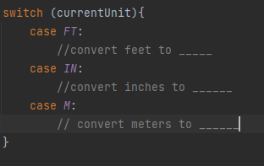
Using switch case logic to determine which conversion to perform, we get left with multiple paths
This is an example of where we can benefit from path coverage testing.

